Slide 1


FLORIDA INTERNATIONAL UNIVERSITY
Predicting 30-Day Hospital Readmission in Medicare Patients
Thiago Bandeira | Track: Business Analytics
Armando Gonzalez | Track: Artificial Intelligence
Mentor: Christian Poellabauer
April 13th , 2026

Slide 2

FLORIDA INTERNATIONAL UNIVERSITY
Motivation & Background
30-day readmissions are a major healthcare challenge, linked to high costs and poorer outcomes.
Medicare beneficiaries (age 65+) are particularly vulnerable to readmissions.
Reducing readmissions is a key national priority, reinforced by CMS through the Hospital Readmissions Reduction Program (HRRP).
Data-driven prediction at discharge can help primary care providers identify at-risk patients early and enable timely interventions.
$26B+
Annual cost of
unplanned readmissions
Source: Centers for Medicare & Medicaid Services (CMS), Hospital Readmissions Reduction Program.

Slide 3
FLORIDA INTERNATIONAL UNIVERSITY
Problem Definition
Challenge: Identifying Medicare patients at highest risk of 30-day readmission is difficult at the time of discharge.
Goal: Develop a predictive model using MIMIC-IV v3.1 dataset to assess readmission risk for Medicare beneficiaries.
Outcome: Deliver an interpretable risk-scoring tool that supports primary care providers with targeted interventions.
Impact: Missed risk predictions → avoidable hospitalizations, higher costs, poorer patient outcomes.

Slide 4
FLORIDA INTERNATIONAL UNIVERSITY
Research Questions
RQ1: Which features are most predictive of 30-day readmissions in Medicare beneficiaries?
RQ2: Which modeling approach (statistical, boosting, deep learning, or ensemble) achieves the best predictive performance?
RQ3: Can interpretable ML methods (e.g., SHAP) provide actionable insights for primary care providers at discharge?

Slide 5
FLORIDA INTERNATIONAL UNIVERSITY
Dataset
Key Clinical Modules
Source: MIMIC-IV v3.1 (PhysioNet) from Beth Israel Deaconess Medical Center, Boston, MA.
Full Dataset: 546,028 admissions with 305 raw features.
Cohort: 244,576 Medicare admissions (insurance == Medicare)
Target: readmit_30d (binary) (21.1% positive rate)
Admissions
Diagnoses (ICD-9/10)
Procedures
DRG Codes
Prescriptions
Lab Events
Vital Signs
ICU Stays
Transfers
Microbiology
Source: Johnson et al., “MIMIC-IV, a freely accessible electronic health record dataset,” Scientific Data, 2023.

Slide 6
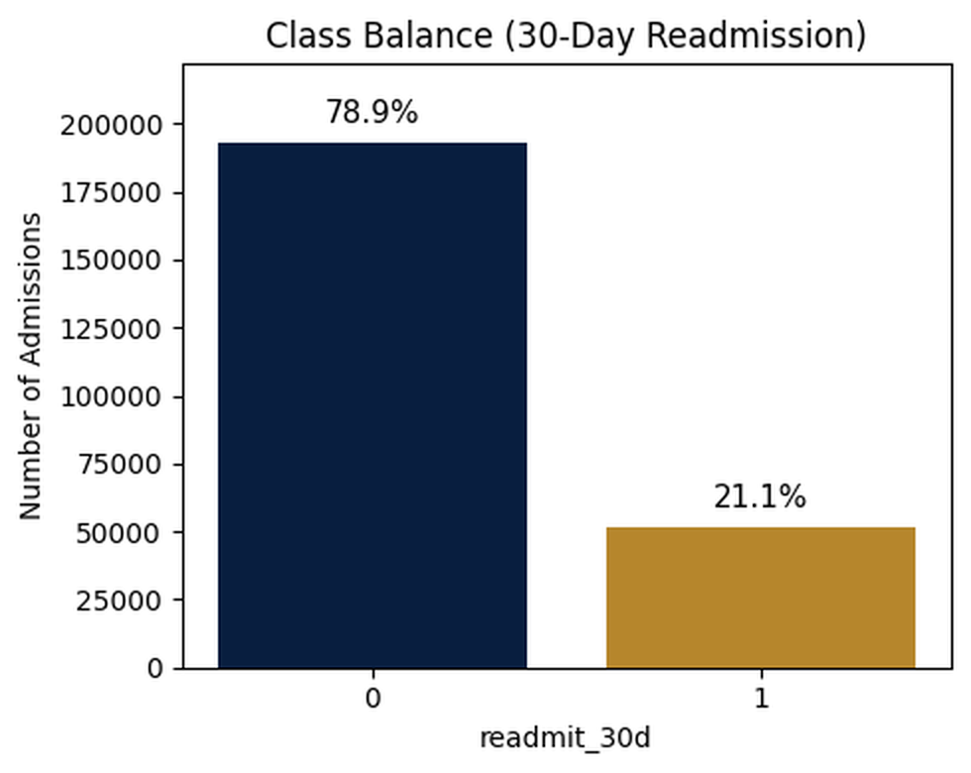
FLORIDA INTERNATIONAL UNIVERSITY
Exploratory Data Analysis (EDA)
Dataset is imbalanced: 21.1% of admissions were readmitted within 30 days
Imbalance justifies using AUC-ROC and calibrated probabilities instead of accuracy
Feature distributions (age, Length of Stay (LOS), comorbidities, meds) show broad clinical variability
No strong multicollinearity detected among baseline features (not shown for simplicity)

Slide 7
FLORIDA INTERNATIONAL UNIVERSITY
Exploratory Data Analysis (EDA)
Discharge Destination
Readmission Rate by Discharge Destination
N = number of admissions | Overall cohort rate: 21.1%
Takeaways: 1. Discharge destination shows wide variation in readmission rates (3.9% to 50.3%), suggesting strong predictive potential. 2. Care-coordination interventions can target the 56K Home Health patients readmitting at 25.1%.
Psych Facility
50.3%
(n=1,049)
Against Medical Advice
36.3%
(n=1,060)
Acute Hospital Transfer
33.3%
(n=1,204)
Chronic/LTAC
27.4%
(n=5,586)
Home Health Care
25.1%
(n=56,615)
Skilled Nursing Facility
21.8%
(n=42,312)
HOME
19.9%
(n=62,075)
Rehab
18.8%
(n=8,684)
Hospice
3.9%
(n=3,566)
21.1%
cohort avg
Chronic/LTAC = Long-Term Acute Care facilities

Slide 8
FLORIDA INTERNATIONAL UNIVERSITY
Dataset Versions V1-V7
V1: 21 Features
V2: 24 Features
V3: 28 Features
V4: 33 Features
V6: 40 Features
V5: 36 Features
V7: 50 Features

Slide 9
FLORIDA INTERNATIONAL UNIVERSITY
Dataset Versions V1-V6
Version 4 – Clinical Severity & Interaction Features
Added 5 engineered features on top of V3:
Age buckets (age_bucket)
Age grouped into 4 clinical bands (lt65, 65–74, 75–84, 85+).
Comorbidity score (cci_total)
Sum of all CCI flags to create a single measure of comorbidity burden.
Admission acuity score (admission_type_ord)
Admission type mapped to an ordered severity scale (ELECTIVE=0 → TRAUMA=3).
Age × comorbidity (age_cci_interaction)
Interaction term capturing patients who are both older and highly comorbid.
Length of Stay × comorbidity (los_cci_interaction)
Interaction term capturing long stays combined with higher comorbidity.
Version 3 – Data Quality & Length of Stay Refinement:
Adds 4 engineered features on top of V2:
Recomputed Length of Stay (los_days) – calculated directly as (discharge − admit) ÷ 24 to ensure consistent LOS across all encounters
Diagnosis Related Group (DRG) missing flag (drg_code_is_missing) – 1 if DRG code is null, capturing unusual billing or incomplete documentation
Discharge missing flag (discharge_location_is_missing) – 1 when discharge disposition is absent, signaling atypical workflows
Length of Stay missing flag (los_days_is_missing) – identifies encounters with incomplete timestamps or irregular LOS patterns
Version 1 – Baseline Feature Set:
Demographics: age, gender
Admission info: admission type, admission location, discharge location
Comorbidities (7 flags): MI, CHF, diabetes, COPD, cerebrovascular, renal, cancer
Stay context: Length of Stay (LOS), discharge hour, weekend discharge
Medication burden: distinct drugs, polypharmacy flag
Prior use (6 months): prior admissions, mean prior LOS, any ED
Diagnosis Related Group (DRG) code
Version 5 – Nonlinear & Interaction Enhancements
Added 3 engineered features on top of V4:
Length of Stay × Age (los_age_interaction)
Engineered feature: los_days * age_at_admit
Captures nonlinear risk for older patients with long stays.
Squared comorbidity score (cci_total_sq)
Engineered feature: cci_total ** 2
Amplifies risk for very high comorbidity burden.
Log-transformed Length of Stay (log_los_days)
Engineered feature: log1p(los_days)
Reduces effect of extreme LOS values and stabilizes long-stay distributions.
Version 6 — Clinical Feature Expansion
In V6, I expanded the dataset by adding raw clinical information from other MIMIC-IV tables:
Added Clinical Features (Aggregated per admission):
Diagnosis complexity: n_diagnoses
Procedure complexity: n_procedures
Medication burden: n_meds_total, n_meds_unique
Lab intensity: n_labs_total, n_lab_item_types, n_labs_abnormal
ICU utilization: icu_flag, icu_total_hrs
Patient history: prior_admissions_all
Version 2 – Temporal & Complexity Signals added:
Added 3 engineered features on top of V1:
Prior DRG + discharge disposition: combined category (last_drg_dispo) from the previous admission
Medication complexity (last 90 days): Shannon entropy of medication classes (med_entropy_90d)
Length of Stay (LOS) trend across admissions: mean change in length of stay vs the prior admission (los_trend_180d)
Table 1: Feature count per model version, showing progressive enrichment from V1 to V6.
Version | Feature Count
V1 | 21
V2 | 24
V3 | 28
V4 | 33
V5 | 36
V6 | 40
Notes:
Note: This slide uses step-by-step animations. Versions V1–V6 appear sequentially during the presentation; the overlapping text only occurs in edit mode.

Slide 10
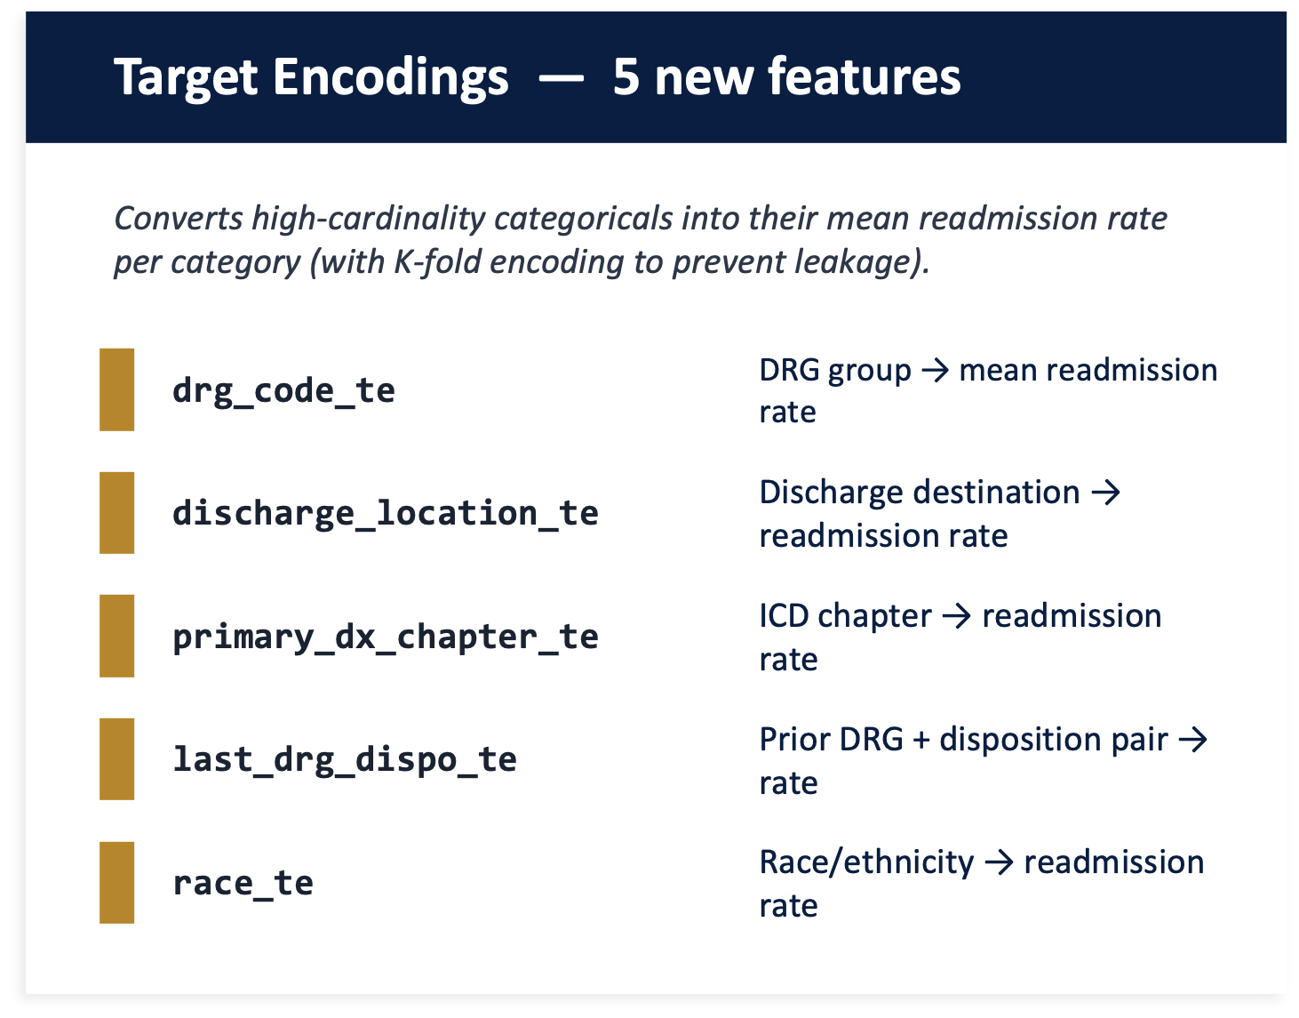
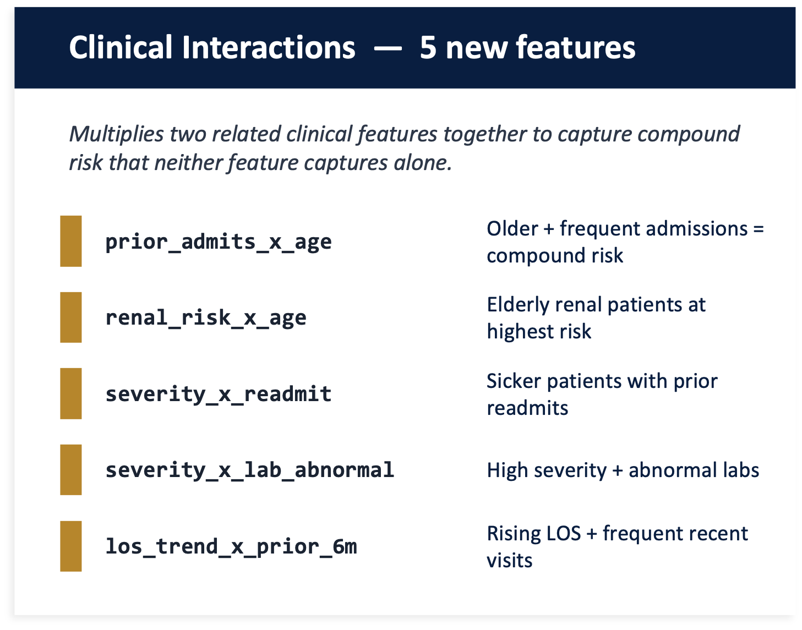
FLORIDA INTERNATIONAL UNIVERSITY
Dataset Version V7
V6 established 40 core clinical features. V7 adds 10 advanced features in two categories to capture non-linear relationships the base features miss.
DRG = Diagnosis-Related Group | ICD = Diagnosis coding system | LOS = Length of Stay | dx = Diagnosis

Slide 11
FLORIDA INTERNATIONAL UNIVERSITY
Feature Expansion V7
V1 → V7
+0.086 AUROC gain
Core clinical features
V7 → Expanded
+0.005 AUROC gain
Minimal improvement
A core set of ~50 clinically-motivated features captures 99.4% of the predictive signal. Additional feature engineering yields only marginal improvement, confirming the parsimonious model as ideal for deployment.

Slide 12
FLORIDA INTERNATIONAL UNIVERSITY
Model Performance

Slide 13
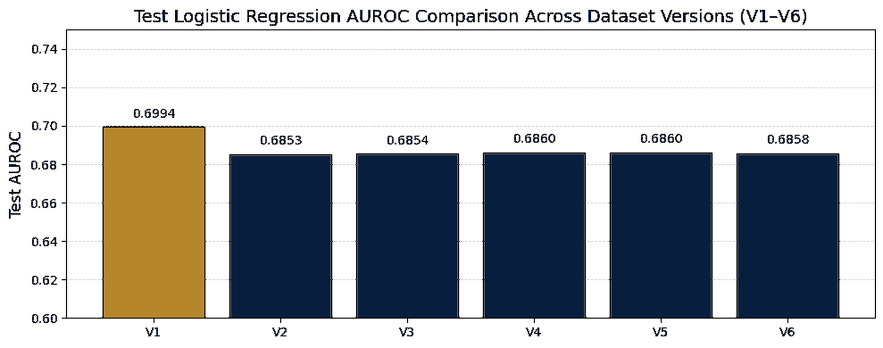
FLORIDA INTERNATIONAL UNIVERSITY
Logistic Regression Performance
V1 of the Dataset gets the best performance from this baseline model
With increasing dataset complexity, the logistic regression model starts to underfit.

Slide 14
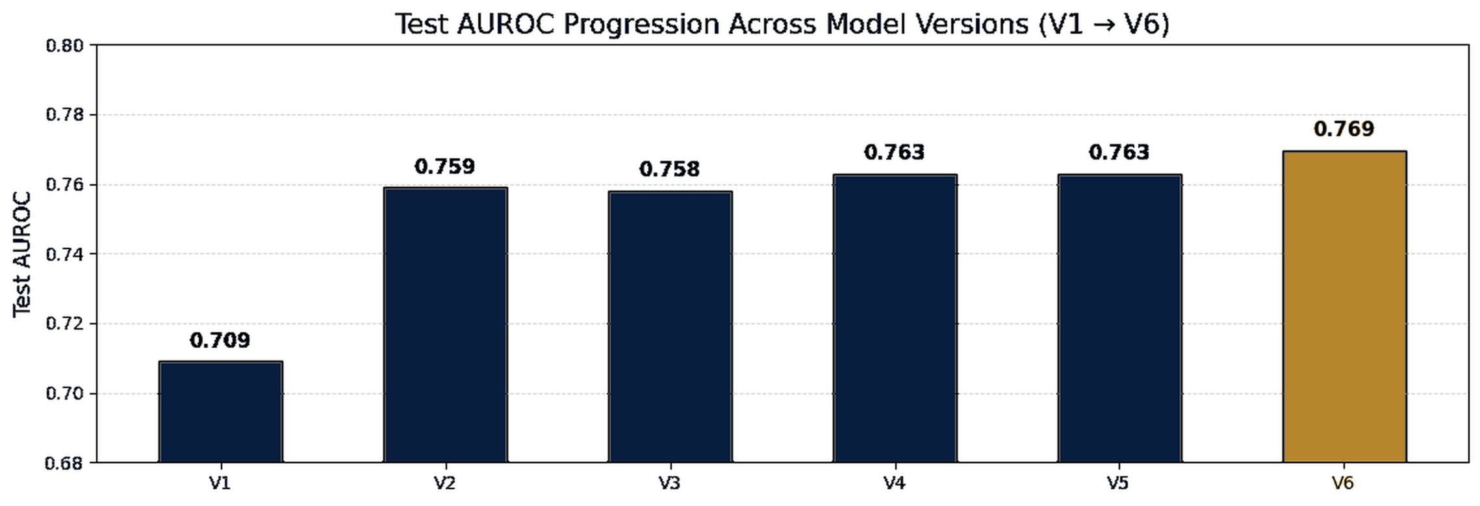
FLORIDA INTERNATIONAL UNIVERSITY
LightGBM
Model Performance
V1: Baseline, lowest performance (0.709)
V2: Biggest jump from added complexity
V3-V5: No significant gains from additional features
V6: Clinical counts boosted final AUROC (0.769)

Slide 15
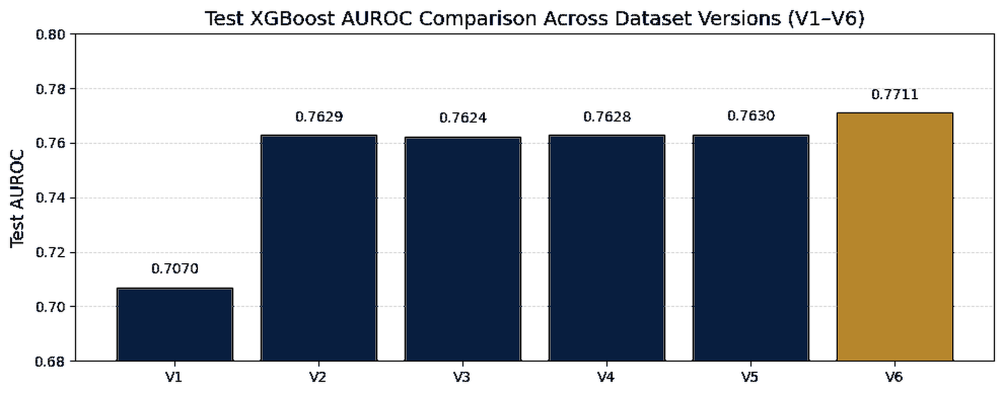
FLORIDA INTERNATIONAL UNIVERSITY
XGBoost Performance
V1: Baseline dataset with low features gave us low performance (0.7070)
V2: Biggest jump from added features and complexity (0.7629)
V3-V5: No Significant Gains
V6: Clinical counts features boosted final AUROC (0.7711)

Slide 16
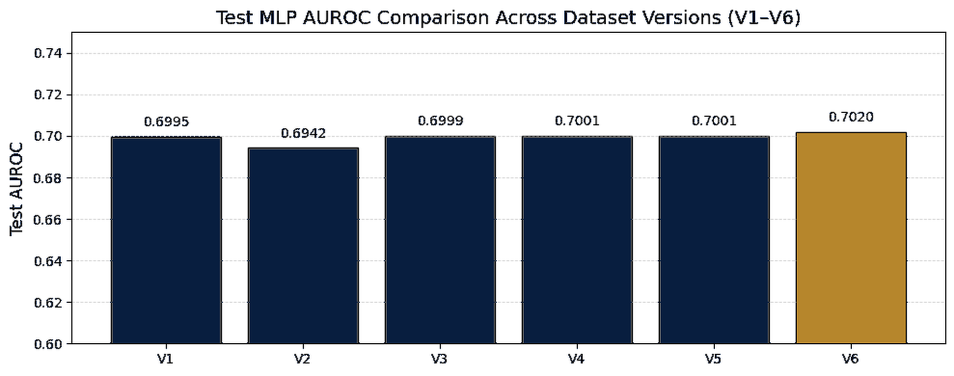
FLORIDA INTERNATIONAL UNIVERSITY
MLP Performance
V6 obtains the best result but not by a significant margin.
Current Best Model Layer Architecture of [128, 64] may be underfitting the complexity required from the datasets.

Slide 17
FLORIDA INTERNATIONAL UNIVERSITY
Advanced Neural Networks
Goal: Capture temporal dynamics, feature interactions and complementary signals beyond basic MLPs
Attention-Based tabular Model
Sequence models that learn from
patient admission history.
Capture temporal patterns across
prior hospitalizations.
Temporal Models
Ensemble Stacking
FT-Transformer
LSTM & GRU Hybrids
Stacking Ensemble
Tokenizes each feature and uses
self-attention to discover
feature-to-feature interactions
automatically.
Combines all architectures via
a meta-learner that weights
each model's predictions
for optimal blending.
LSTM = Long Short-Term Memory · GRU = Gated Recurrent Unit · FT-Transformer = Feature-Tokenizer Transformer

Slide 18
FLORIDA INTERNATIONAL UNIVERSITY
FT-Transformer
How It Works
Why It Adds Value
1 Feature Tokenizer
MLPs
Numeric + categorical features → individual d-dimensional vector
Blend all features together: interactions emerge implicitly through layers
2 [CLS] Token
LightGBM
Learnable summary token prepended to the feature tokens
Finds interactions via sequential tree splits: locally greedy
3 Self-Attention
FT-Transformer
Each token attends to all others: discovers which features interact
Explicitly learns which feature pairs matter via attention: global and differentiable
4 Classification
[CLS] output → LayerNorm → Dense(64) → Sigmoid → readmission probability
Different error patterns → valuable for stacking ensemble
Purpose-built Transformer architecture for tabular data (Gorishniy et al., 2021)
FT-Transformer = Feature-Tokenizer Transformer | [CLS] = Classification token

Slide 19
FLORIDA INTERNATIONAL UNIVERSITY
GRU+MLP Architecture
Table 2. Test AUROC
How the Hybrid Model Works
Model Family | Best Model | AUROC
Hybrid GRU | HybridGRU_1L32 | 0.7711
Hybrid LSTM | Hybrid_LSTM32 | 0.7695
Standalone RNN | BiGRU_2L64 | 0.6365
Sequence Branch
10 prior admissions × 15 temporal features → GRU layers → temporal representation
Static Branch
25 numeric features + 5 categorical embeddings → Dense layers
Key finding: Standalone RNNs (0.636) confirm that sequences alone are insufficient. The hybrid approach combining temporal + static features is essential.
Fusion Layer
Concatenate both branches → Dense(128) → Dense(64) → Sigmoid
GRU = Gated Recurrent Unit · LSTM = Long Short-Term Memory · MLP = Multi-Layer Perceptron · RNN = Recurrent Neural Network

Slide 20
FLORIDA INTERNATIONAL UNIVERSITY
Stacking Ensemble with
Meta Learn
Layer 1: Base Models (trained independently)
Hybrid
GRU×4
MLP
×2
FT-Transformer
×3
LightGBM
×2
▼ Each model produces probability predictions ▼
Layer 2: Meta-Learner (Logistic Regression)
Learns optimal weights: which model to trust for which patients
▼
Final Prediction: AUROC = 0.7778
MLP = Multi-Layer Perceptron · GRU = Gated Recurrent Unit · FT-Transformer = Feature-Tokenizer Transformer

Slide 21
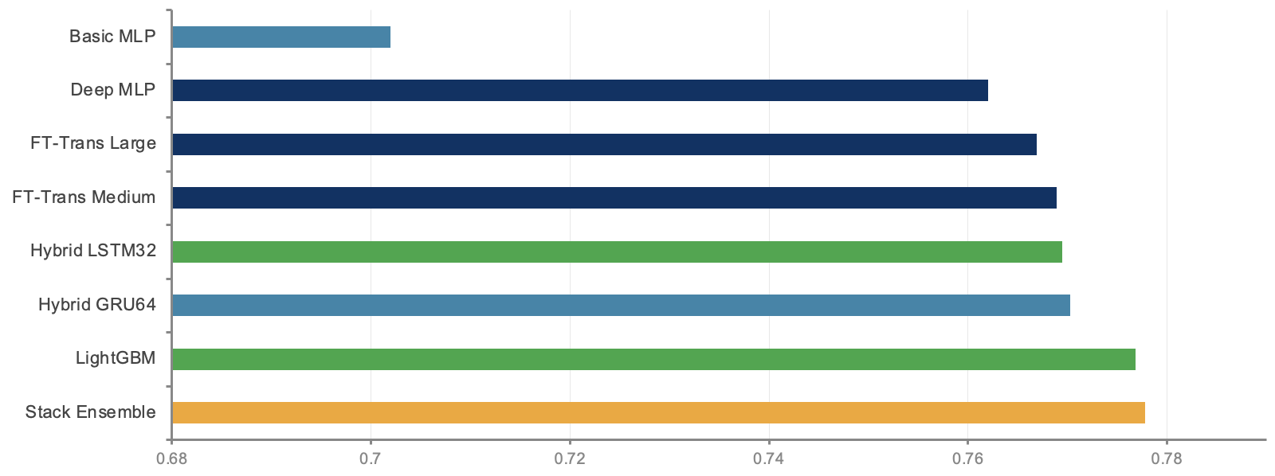
FLORIDA INTERNATIONAL UNIVERSITY
AUC-ROC Results on V6
0.7778
Test AUC-ROC across all model families and ensembles (V6 dataset, 244K admissions)
GRU = Gated Recurrent Unit · LSTM = Long Short-Term Memory · MLP = Multi-Layer Perceptron · RNN = Recurrent Neural Network · FT-Trans = Feature Tokenizer Transformer

Slide 22
FLORIDA INTERNATIONAL UNIVERSITY
Boosting: Four-Model Ensemble with V7
LightGBM
XGBoost
CatBoost
HistGBM
0.790
0.793
0.792
0.792
AUROC
AUROC
AUROC
AUROC
Histogram-based,
leaf-wise growth.
Fast training, handles categoricals.
Lossguide tree policy
Best individual performer
Ordered boosting
Native categorical handling
Sklearn histogram gradient
Native missing value support

Slide 23
FLORIDA INTERNATIONAL UNIVERSITY
Ensemble Blending Strategy
LightGBM
19%
Blending Details
Scipy minimize with AUROC objective on Out-of-Fold predictions
XGBoost
30%
Scipy-Optimized
Blend
AUROC: 0.795
Constrained: weights sum to 1.0, each weight in [0, 1]
10 random seeds per model for variance reduction
Out-of-fold predictions prevent overfitting in meta-learner
CatBoost
30%
XGBoost and CatBoost receive highest weight (30% each)
HistGBM
21%

Slide 24




FLORIDA INTERNATIONAL UNIVERSITY
Why Gradient Boosting for V7?
Temporal Features
Not in V7
Diminishing
Returns
Interpretability
Required
V7: 50 Static
Features
GRU/LSTM hybrids used 10 prior admissions × 15 temporal features. V7's new features are all static tabular, there is no sequences to leverage.
Best ensemble (0.778) beat best single GBM (0.769) by only +0.009 AUROC. Neural nets did not outperform boosting on V6.
GBMs support full SHAP attribution which is essential for actionable discharge insights and answering RQ3.
V6 (40 feat) + 5 target encodings + 5 clinical interactions = 50 features. All tabular → ideal for GBM architectures.
Conclusion: GBMs are the optimal architecture for V7 matching the data structure, preserving interpretability, and achieving 0.795 AUROC

Slide 25
FLORIDA INTERNATIONAL UNIVERSITY
Final Model Comparison:
V1 vs V6 vs V7 vs Expanded
Table 3. Final model comparison across dataset versions: Best AUROC, model type, interpretability, and deployment complexity.
Metric | V1 (21 feat) | V6 (40 feat) | V7 (50 feat) | Expanded
Best AUROC | 0.709 | 0.778 | 0.795 | 0.800
Best Model | Logistic Reg. | Stacking | 4-GBM Blend | 4-GBM Blend
Interpretability | High | Moderate | High | Low
Deploy Complexity | Low | High | Low | Very High
V7 achieves 99.4% of the expanded model's performance with a compact, interpretable feature set. Additional feature engineering beyond the core clinical domains yielded only marginal improvement (+0.005 AUROC).

Slide 26
FLORIDA INTERNATIONAL UNIVERSITY
Benchmark Comparison
30-Day All-Cause Readmission Prediction on MIMIC Data
Key Takeaways
Published Benchmarks
Study
Approach
AUROC
Outperforms Traditional Scores
Our model surpasses the LACE index by +0.111 AUROC, a 16% relative improvement
LACE Index (van Walraven et al., 2010)
Traditional Clinical Score
0.684
Huang et al., 2020 (ClinicalBERT)
BERT + Clinical Notes
0.714
Exceeds NLP-Based Approaches
Ours (2026)
GBM Ensemble (50 features)
0.795
Achieves higher AUROC than ClinicalBERT without requiring clinical notes or NLP pipelines
Structured Data Only
50 interpretable engineered features from structured EHR data — no notes, imaging, or temporal graphs
Clinically Deployable
Parsimonious feature set maps directly to actionable care interventions at discharge
Sources: van Walraven et al. (CMAJ, 2010); Huang et al. (arXiv, 2020)

Slide 27
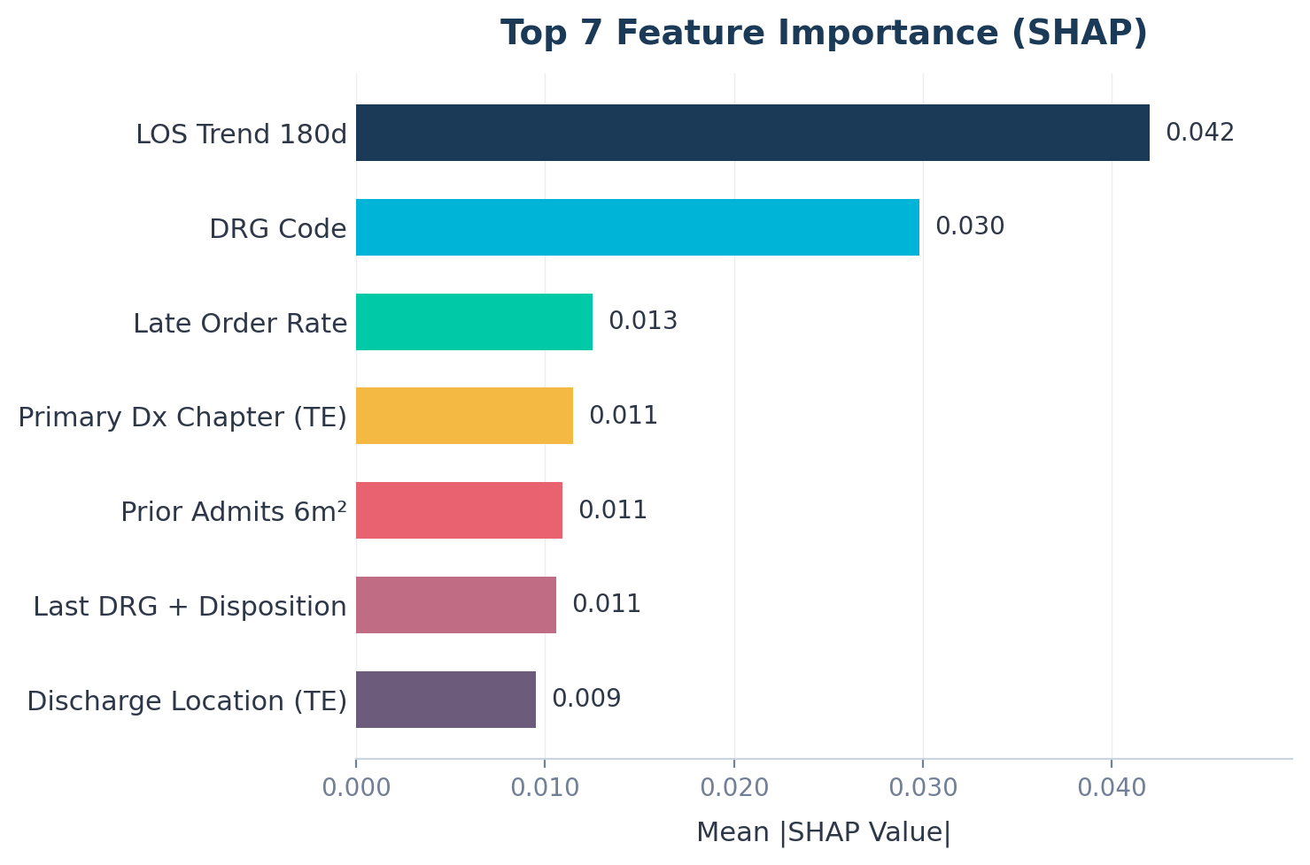
FLORIDA INTERNATIONAL UNIVERSITY
SHAP: Top 7
Feature Explanations
Top 7 — Clinical Insights
LOS Trend 180d — Rising stay lengths over 6 months are the strongest signal of instability
DRG Code — Clinical mix carries enormous predictive power (11–66% readmission range)
Late Order Rate — Operational chaos during stay predicts post-discharge failure
Primary Dx Chapter — Disease category shapes baseline risk profile
Prior Admits 6m² — Acceleration in utilization compounds risk non-linearly
Last DRG + Disposition — Prior discharge pathway predicts future readmission patterns
Discharge Location — Where patients go after discharge directly impacts readmission risk
SHAP: SHapley Additive exPlanations. | LOS: Length of Stay. | DRG: Diagnosis-Related Group. | Dx: Diagnosis. | TE: Target Encoding.

Slide 28
FLORIDA INTERNATIONAL UNIVERSITY
Answering the Research Questions
RQ1
Most Predictive Features
LOS trend (180d), DRG code, discharge location, prior admission history, and clinical interactions are the top predictors. A core set of 50 features captures 99.4% of predictive performance.
RQ2
Best Modeling Approach
XGBoost (AUROC: 0.793) was selected over the top-performing blended ensemble (0.795), as the negligible 0.002 difference does not justify the added complexity and XGBoost preserves full feature interpretability for actionable insights.
RQ3
Actionable SHAP Insights
SHAP provides patient-level explanations: providers see which factors drive each individual's risk. Key: LOS monitoring, medication reconciliation, early follow-up for frequent admitters.

Slide 29
FLORIDA INTERNATIONAL UNIVERSITY
Limitations
Single Hospital System
Data from Beth Israel Deaconess (Boston) only, which may limit generalizability to other hospitals, regions, or populations.
No Unstructured Clinical Notes
Physician notes, discharge summaries, and radiology reports were not used. NLP-based features could improve predictions.
No Social Determinants of Health
Housing stability, social support, health literacy, and transportation are known risk factors but unavailable in MIMIC-IV.
Diminishing Returns
Expanding features beyond the core clinical set yielded only marginal improvement, suggesting a ceiling with available structured data.
Temporal Limitation
30-day readmissions occurring at different hospitals are not captured in MIMIC-IV.

Slide 30
FLORIDA INTERNATIONAL UNIVERSITY
Future Work
External Validation
NLP Integration
Test on data from other hospital systems to assess generalizability.
Incorporate unstructured clinical notes using text mining for richer patient context.
Real-Time Deployment
Fairness Analysis
Develop an API/dashboard for real-time risk scoring within EHR workflows at discharge.
Evaluate performance across demographic subgroups to identify and mitigate biases.
Causal Inference
Cost-Effectiveness
Move beyond prediction to identify causal factors enabling more effective interventions.
Quantify the economic impact of implementing the prediction model in hospital operations.
NLP: Natural Language Processing (analyzing clinical text). | API: Interface that connects systems. | EHR: Electronic Health Record

Slide 31
FLORIDA INTERNATIONAL UNIVERSITY
Questions or Comments
Thank you!

